Slide 1
C++ -> Java - A High School Teacher's Perspective
David B. Levine and Alyce Brady

Slide 2
Motivation
Question at a College Board Workshop
“How much (and what) will change
when I switch from teaching C++ to teaching Java?”

Slide 3
Today’s Approach
Consider a few representative topics in each language
Show examples
Make comparisons

Slide 4
Control Structures in C++
Counting Odd Elements in a 20-element array
int oddCount = 0;
for (int j=0; j<20; j++)
{
if (A[j] % 2 == 1)
{
oddCount++;
}
}

Slide 5
Control Structures in Java
Counting Odd Elements in a 20-element array
int oddCount = 0;
for (int j=0; j<20; j++)
{
if (A[j] % 2 == 1)
{
oddCount++;
}
}

Slide 6
Variable declarations in C++
// Primitives
int x;
double d;
bool done;
// Objects
Coin penny;
Dice cube(6);

Slide 7
Variable declarations in Java
// Primitives
int x;
double d;
boolean done;
// Objects
Coin penny = new Coin();
Dice cube = new Dice(6);

Slide 8
Variable declarations in Java
// Primitives
int x;
double d;
boolean done;
// Objects
Coin penny = new Coin();
Dice cube = new Dice(6);

Slide 9
Key difference in Java
Variables are references to objects, not objects
Variable declaration merely creates reference, not object
Dice cube;
Must construct objects explicitly
Dice cube = new Dice(6);
Can have multiple references to same object

Slide 10
Member function calls in C++
penny.flip();
robot.moveTo(newLoc);

Slide 11
Method invocation in Java
penny.flip();
robot.moveTo(newLoc);

Slide 12
Parameter Passing
C++
Value (default)
Reference (if specified)
const Reference (if specified)
Java
Value (for primitives)
Value (for object references, so
looks like by reference)
Notes:
In Java, object REFERENCES are passed as parameters, not the objects themselves.
References, like primitives, are passed by value. A method can follow a reference , though, and modify the object.
(Note: since the reference is passed by value, the called method cannot change WHICH object the reference points to (cannot modify the value of the reference) in a way that the calling method would see the change.)

Slide 13
Classes and Objects
C++
public/private/protected data and methods
Specify interfaces through .h files
Topic can be ignored (albeit unadvisedly)
Java
public/private/protected data and methods (declare visibility of each separately)
Specify external view through documentation
Topic CANNOT be ignored (though some try!)

Slide 14
Key difference in Java
Everything is tied to a class
Almost everything is tied to an object
Some data and methods are tied to classes, not objects
public static void main(String[] args)
Math.abs(int i)
System.out.println(String message)

Slide 15
Hello World in C++
#include <iostream.h>
int main()
{
cout << “Hello world” << endl;
return 0;
}

Slide 16
Hello World in Java
public class Hello
{
public static void main()
{
System.out.println(“Hello world”);
}
}

Slide 17
Strings in C++ (AP C++)
apstring s;
apstring s1 = “Hello, ”;
apstring s2(“World”);
apstring s3 = s2;
cout << s1 + s3;

Slide 18
Strings in Java
String s;
String s1 = “Hello, ”;
String s2 = new String(“World”);
String s3 = s2;
System.out.println(s1 + s3);

Slide 19
Strings are Unusual in Java
String constants look like those in C/C++
String s1 = “Hello, ”;
String is only class with operator overloading
System.out.println(s1 + s3);

Slide 20
I/O (A Key Difference)
C++
cin/cout, streams
text-based (graphics are an add-on)
may be tested on the exam
Java
System.out.println(String message);
graphical i/o: forms, applets, text fields, etc
industrial-strength class hierarchy
USE WHATEVER YOUR BOOK SUGGESTS!

Slide 21
Linear Aggregate Structures
C++ arrays
No bounds checking; can’t resize
C++ vectors (apvector)
Bounds checking; resizeable
Java arrays
Bounds checking; can’t resize
Java ArrayLists
Bounds checking; auto-sized; more methods; heterogeneous; O(1) access through “get”

Slide 22
Linked Structures
Java has NO pointers!
Or nothing but pointers!
Java does have linked structures, e.g. linear linked lists, binary trees

Slide 23
Searching a linked list in C++
while (p != NULL)
{
if (key == p->data)
return p;
p = p->next;
}

Slide 24
Searching a linked list in Java
while (p != null)
{
if (key == p.data()) // if primitives
return p;
p = p.next();
}
// or “if (key.equals(p.data()))” // if key and p.data() are objects

Slide 25
Out with the old (and how it changes)
C++
const – more uses than MacGyver’s knife
Operator overloading
delete – to clean up memory management
Java
final – a Pascal/Ada-like use of const
NO operator overloading
Automatic garbage collection

Slide 26
In with the New (and what it used to be)
C++
Inheritance – It’s there, but it’s a pain and generally not taught
Multiple implementations of Abstract Data Types – through classes only
Java
Inheritance (extends) – It’s there and it’s easy
Multiple implementations through implements
keyword

Slide 27
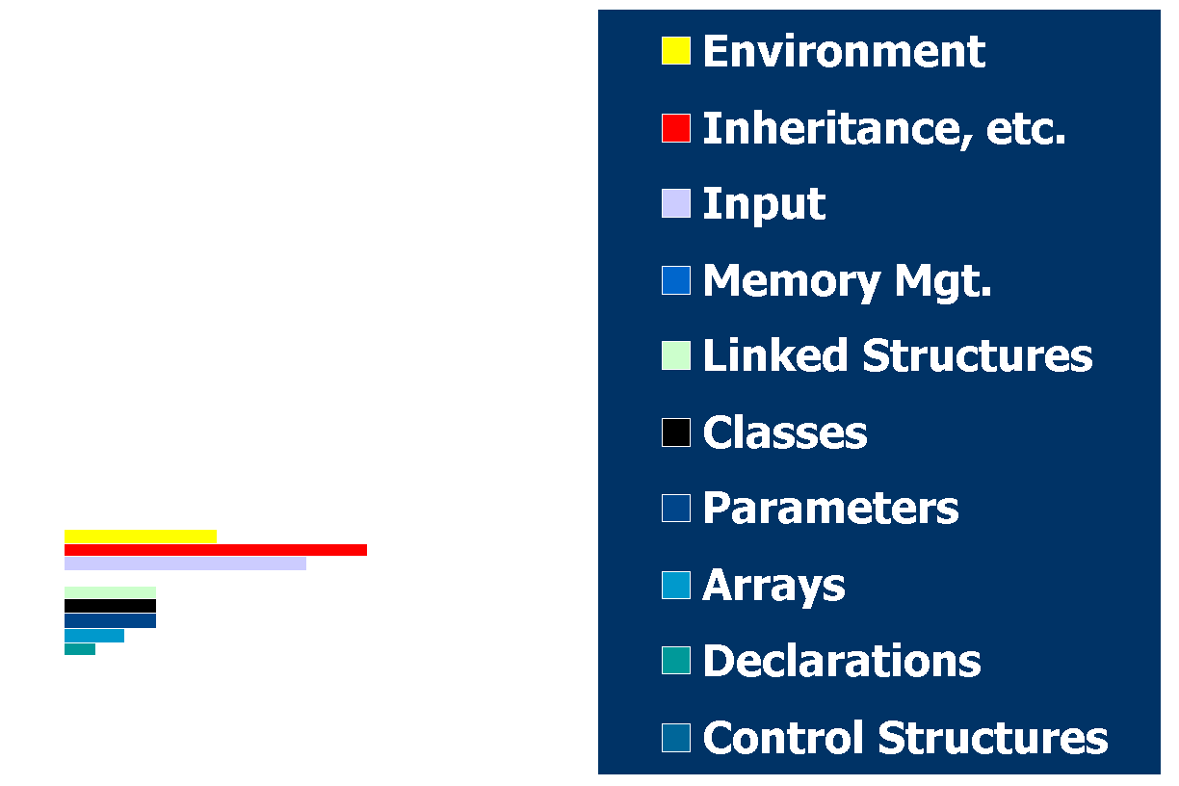
Overall Changes (one man’s opinion)

